Slide 1
WHAT IS A PROGRAMMING LANGUAGE ?
A programming language is a vocabulary and set of grammatical rules for instructing a computer or computing device to perform specific tasks.
The term programming language usually refers to high-level languages, such as BASIC, C, C++, PYTHON , Java and FORTRAN
• Each language has a unique set of keywords (words that it understands) and a special syntax for organizing program instructions.

Slide 2
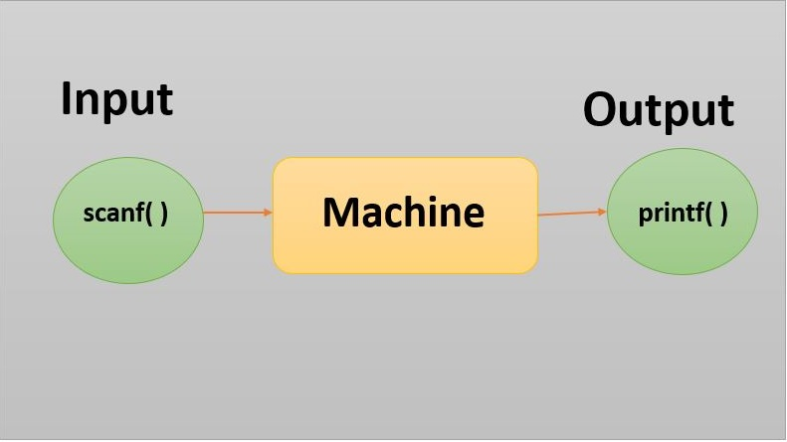

Slide 3
For example : let us assume that we wish to get some work done from a person.
we, hence pass a set of instructions using a communication language like English or French
Likewise , to get certain work done using a computer machine we need to communicate with it.
But the computer understands only binary (0 and 1 ).
Further , By using High level programming languages , we write code which is then
converted into binary for the machine to understand and provide us with output.

Slide 4
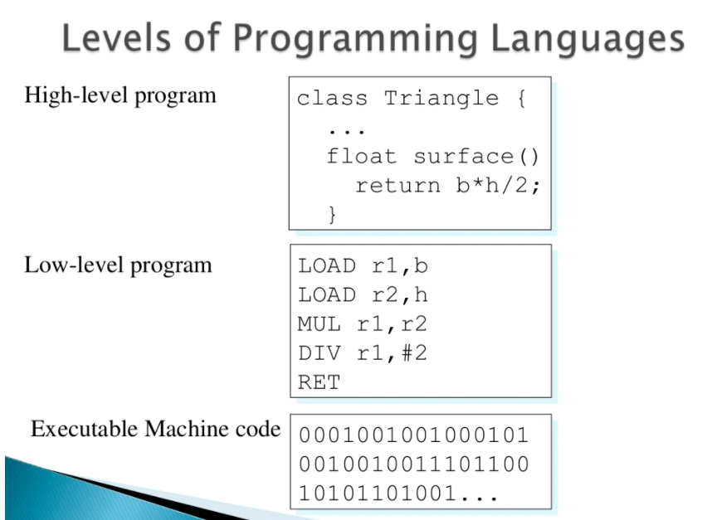

Slide 5
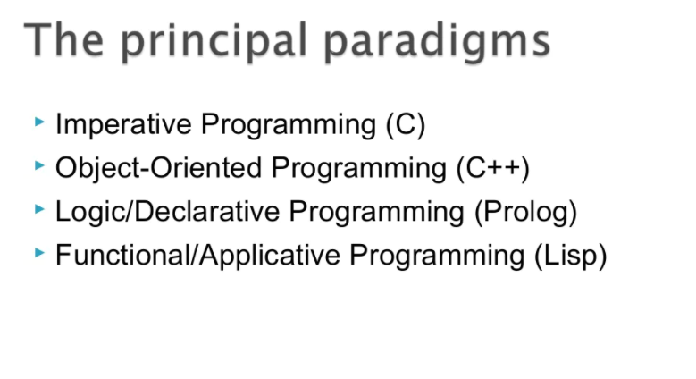
(PYTHON)

Slide 6
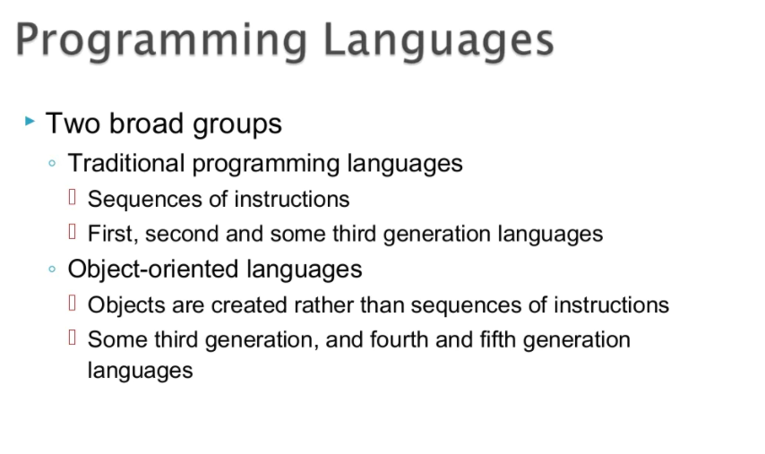

Slide 7
What is object-oriented programming?
Object-oriented programming (OOP) is a computer programming model that organizes software design around data, or objects, rather than functions and logic. An object can be defined as a data field that has unique attributes and behavior.
OOP focuses on the objects that developers want to manipulate rather than the logic required to manipulate them. This approach to programming is well-suited for programs that are large, complex and actively updated or maintained. This includes programs for manufacturing and design, as well as mobile applications; for example, OOP can be used for manufacturing system simulation software.
The organization of an object-oriented program also makes the method beneficial to collaborative development, where projects are divided into groups. Additional benefits of OOP include code reusability, scalability and efficiency

Slide 8
What is the structure of object-oriented programming?
The structure, or building blocks, of object-oriented programming include the following:
Classes are user-defined data types that act as the blueprint for individual objects, attributes and methods.
Objects are instances of a class created with specifically defined data. Objects can correspond to real-world objects or an abstract entity. When class is defined initially, the description is the only object that is defined.
Methods are functions that are defined inside a class that describe the behaviors of an object. Each method contained in class definitions starts with a reference to an instance object. Additionally, the subroutines contained in an object are called instance methods. Programmers use methods for reusability or keeping functionality encapsulated inside one object at a time.
Attributes are defined in the class template and represent the state of an object. Objects will have data stored in the attributes field. Class attributes belong to the class itself.

Slide 9
What are the main principles of OOP
Object-oriented programming is based on the following principles:
Encapsulation. This principle states that all important information is contained inside an object and only select information is exposed. The implementation and state of each object are privately held inside a defined class. Other objects do not have access to this class or the authority to make changes. They are only able to call a list of public functions or methods. This characteristic of data hiding provides greater program security and avoids unintended data corruption.
Abstraction. Objects only reveal internal mechanisms that are relevant for the use of other objects, hiding any unnecessary implementation code. The derived class can have its functionality extended. This concept can help developers more easily make additional changes or additions over time.
Inheritance : Classes can reuse code from other classes. Relationships and subclasses between objects can be assigned, enabling developers to reuse common logic while still maintaining a unique hierarchy. This property of OOP forces a more thorough data analysis, reduces development time and ensures a higher level of accuracy.
Polymorphism :. Objects are designed to share behaviors and they can take on more than one form. The program will determine which meaning or usage is necessary for each execution of that object from a parent class, reducing the need to duplicate code. A child class is then created, which extends the functionality of the parent class. Polymorphism allows different types of objects to pass through the same interface.

Slide 10
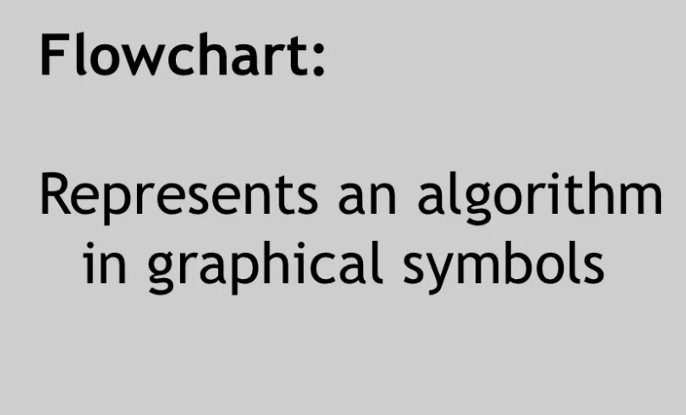

Slide 11
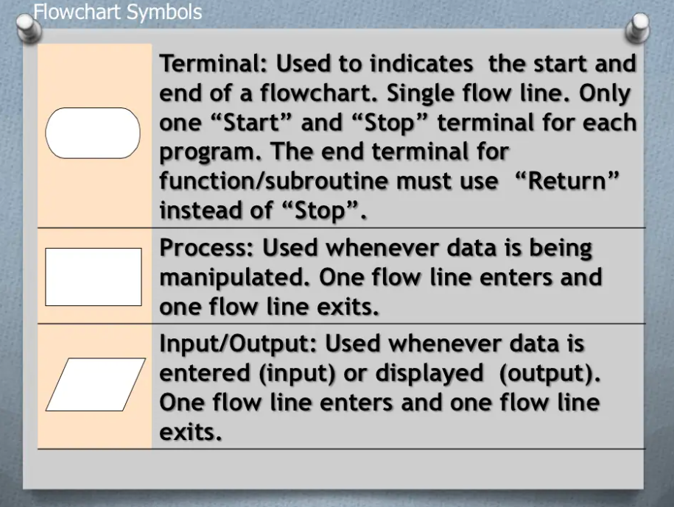

Slide 12
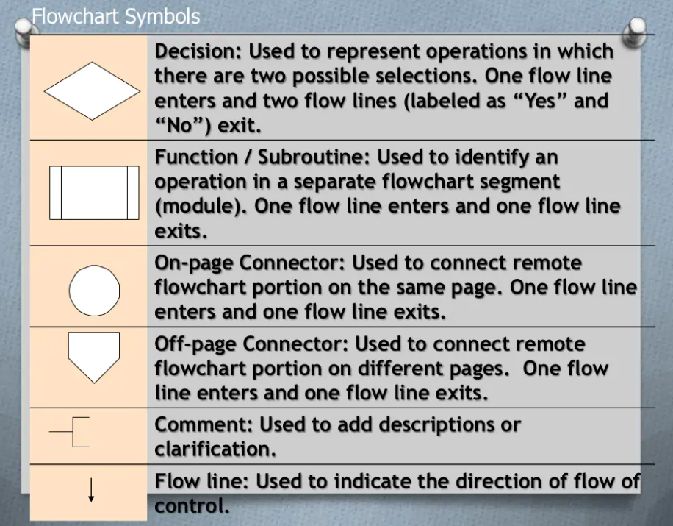

Slide 13
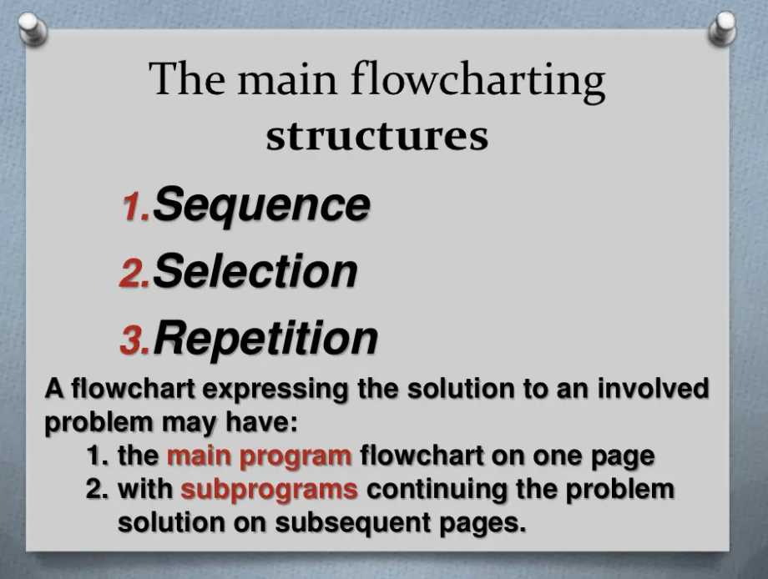

Slide 14
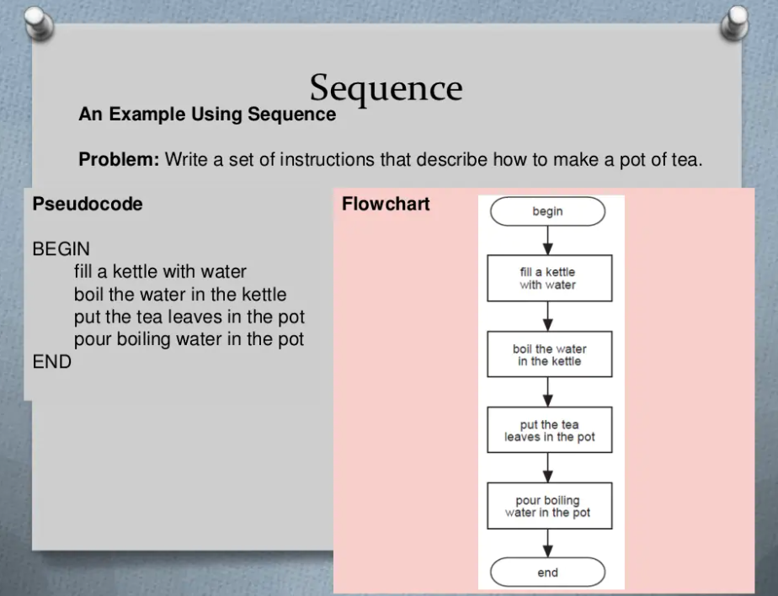

Slide 15
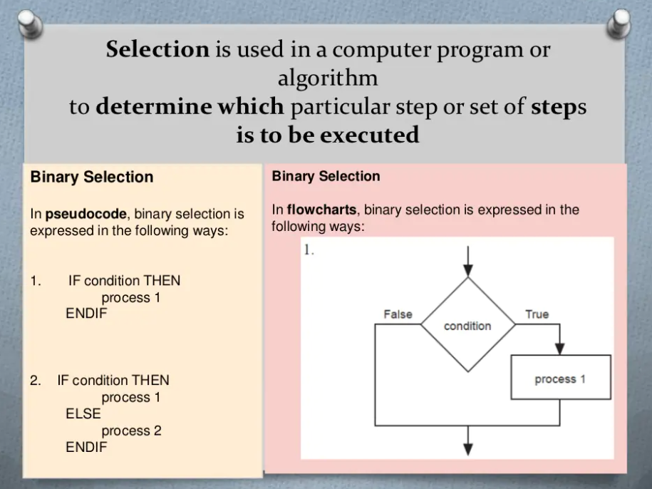

Slide 16
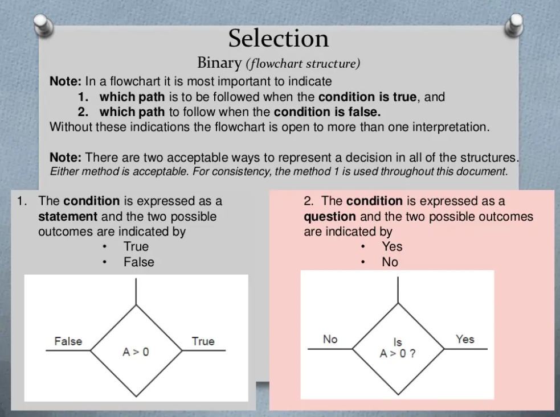

Slide 17
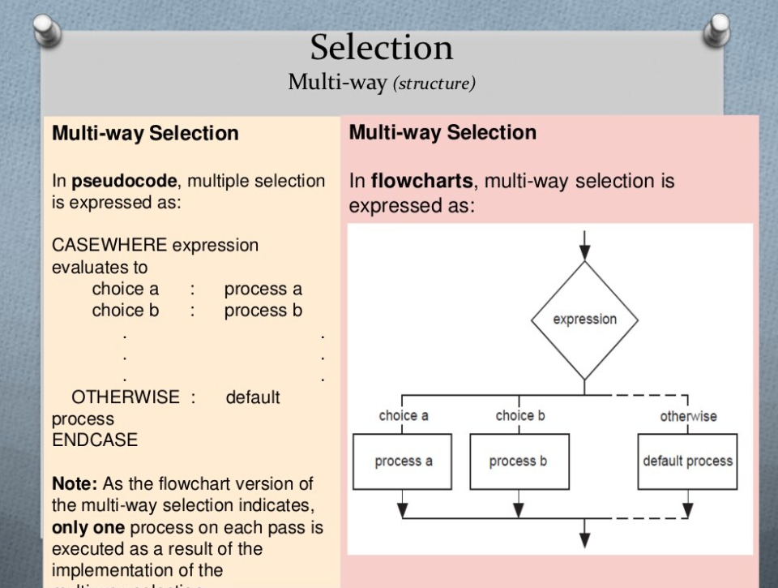

Slide 18
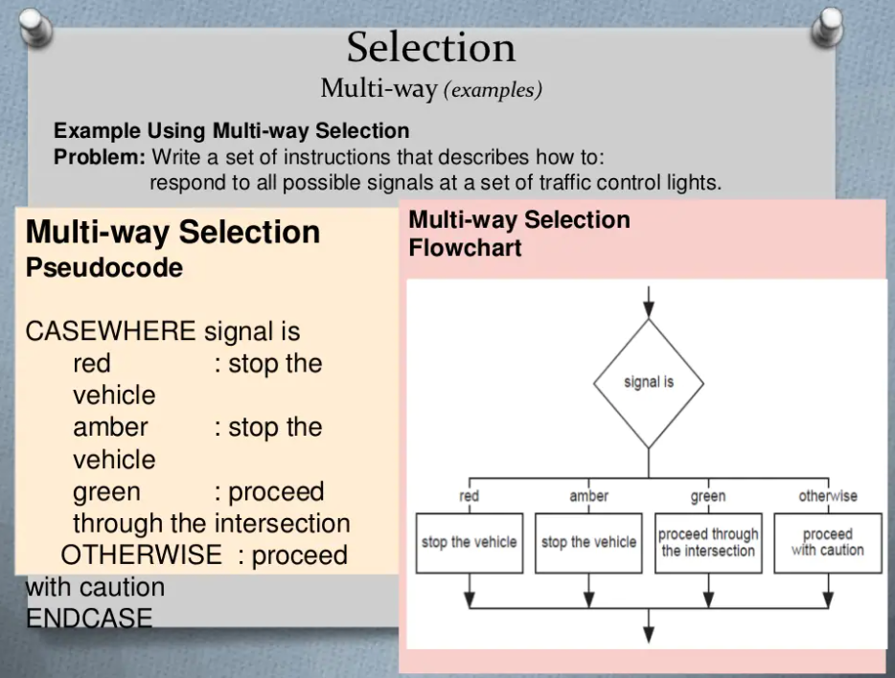

Slide 19
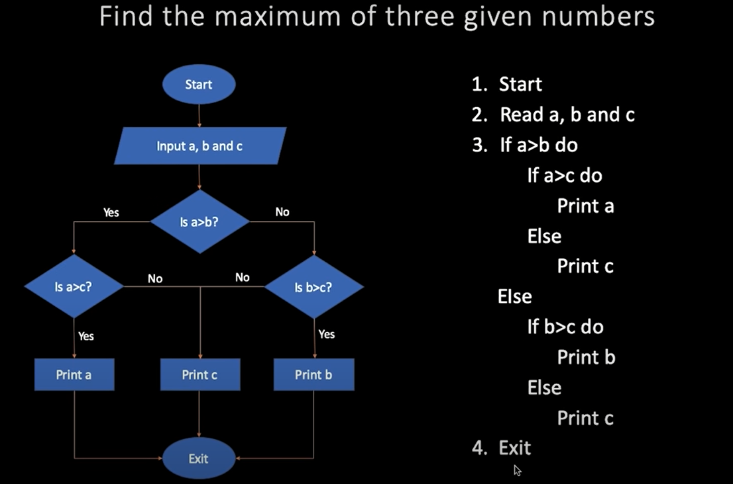
EXAMPLES FOR PSEUDOCODE – 1

Slide 20
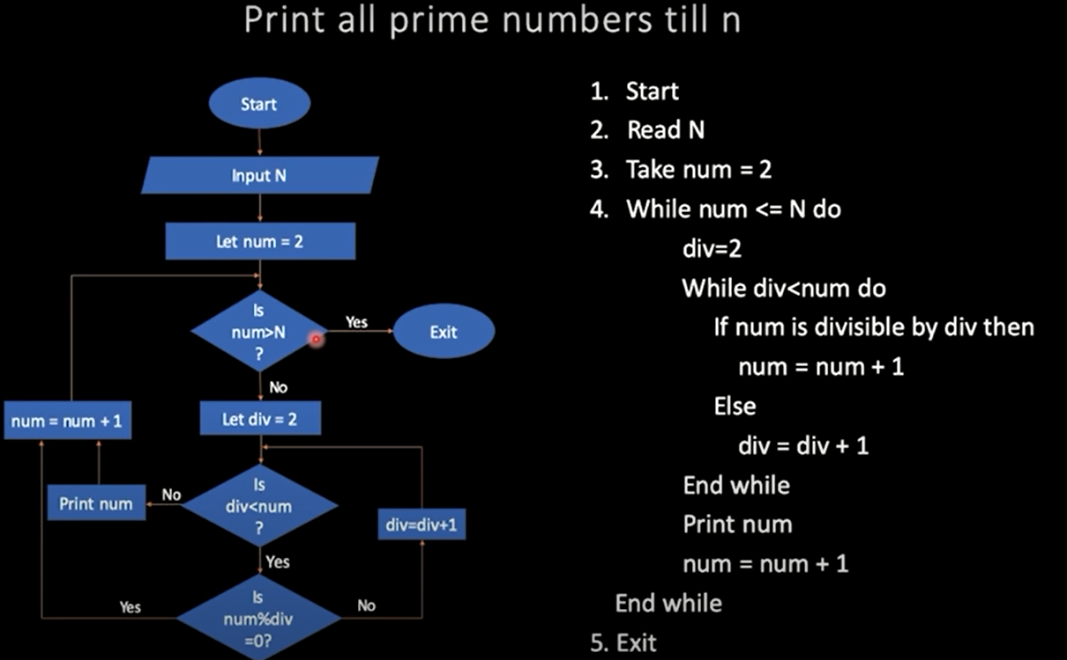
EXAMPLES FOR PSEUDOCODE – 1

Slide 21
What is an IDE?
An IDE, or Integrated Development Environment, enables programmers to consolidate the different aspects of writing a computer program.
IDEs increase programmer productivity by combining common activities of writing software into a single application: editing source code, building executables, and debugging.
An IDE helps in Debugging code.
No programmer avoids writing bugs and programs with errors.
When a program does not run correctly, IDEs provide debugging tools that allow programmers to examine different variables and inspect their code in a deliberate way.
IDEs also provide hints while coding to prevent errors before compilation.
There are various IDE that can be used .
One can also use online or offline interpreters or compilers .
In this session we will be following ANACONDA with jupyter extension.
One may use online interpreters like REPLIT.

Slide 22
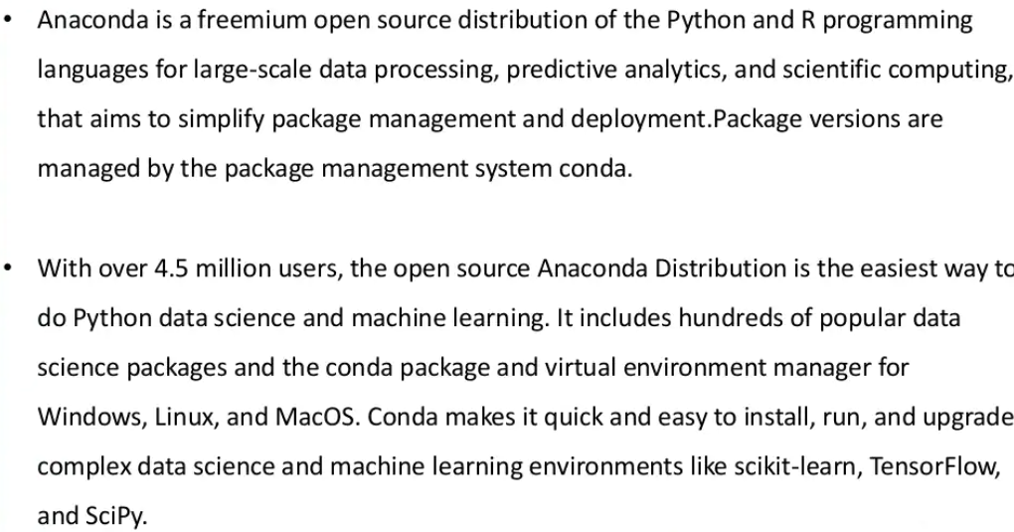

Slide 23

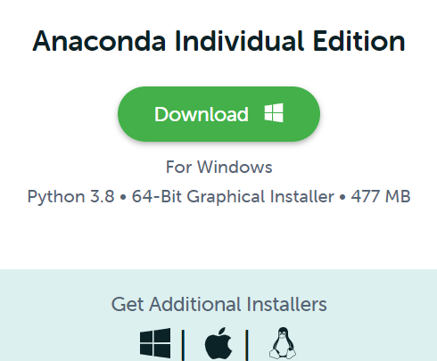
INSTALL ANACONDA

Slide 24
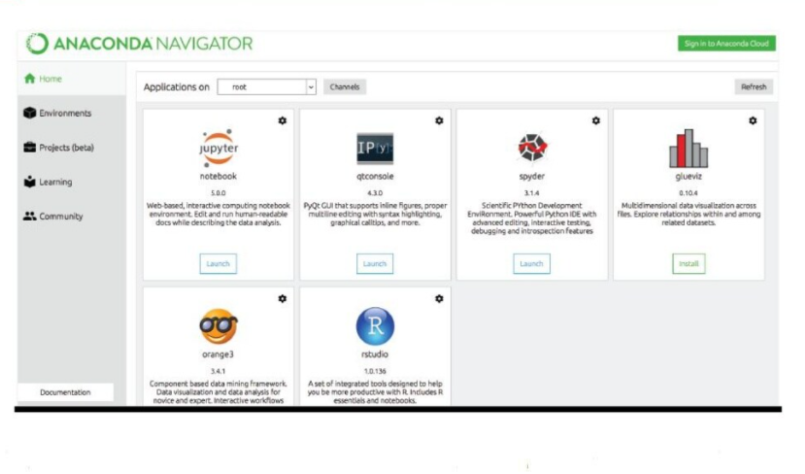
ON INSTALLING ANACONDA , A WINDOW LIKE THE FOLLOWING WILL APPEAR.
LET US START WRITING OUR FIRST CODE !

